Slide 1
Intro to Unity
Collider Component & Camera
Justin Park

Slide 2
What are components?
Components make GameObjects do things
These include
Colliders, which let objects collide
Rigidbody, which applies physics
Animators, which animate the object
Meshes, which let you see the object
Scripts, which YOU get to write to make objects do specific behaviors

Slide 3
Box Collider Component
Let’s make our GameObject bounce when it hits other GameObjects that have a collider component
Note: if the GameObject doesn’t move (like the ground, no need for a rigid body component).

Slide 4
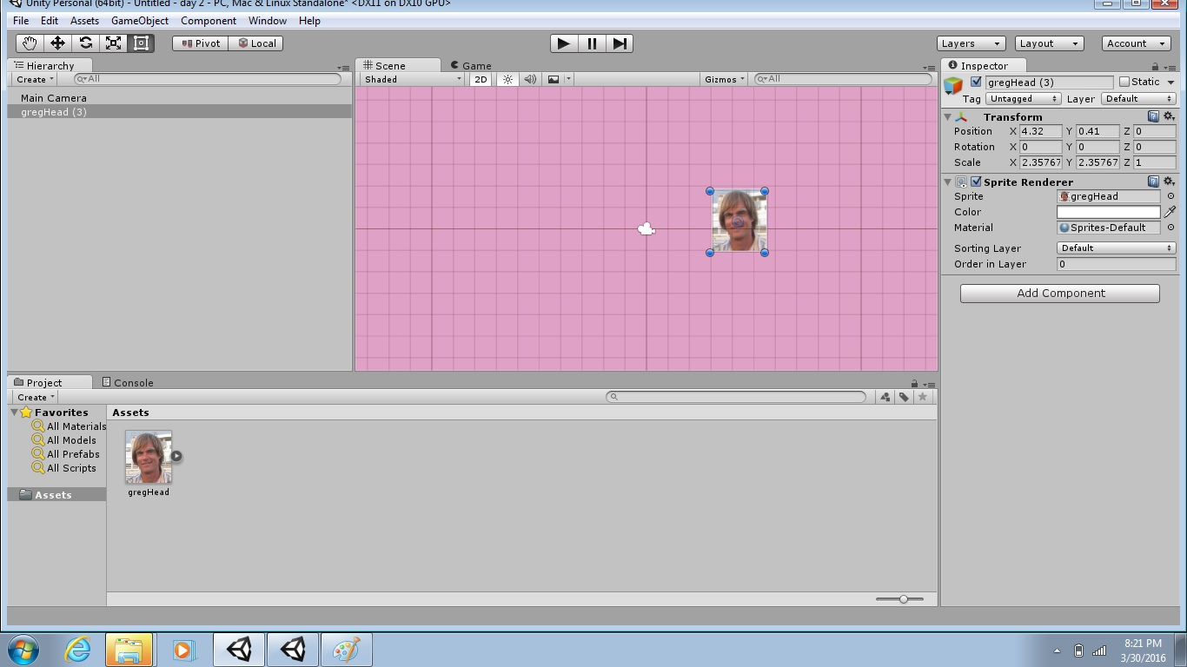
Select “Add Component”

Slide 5
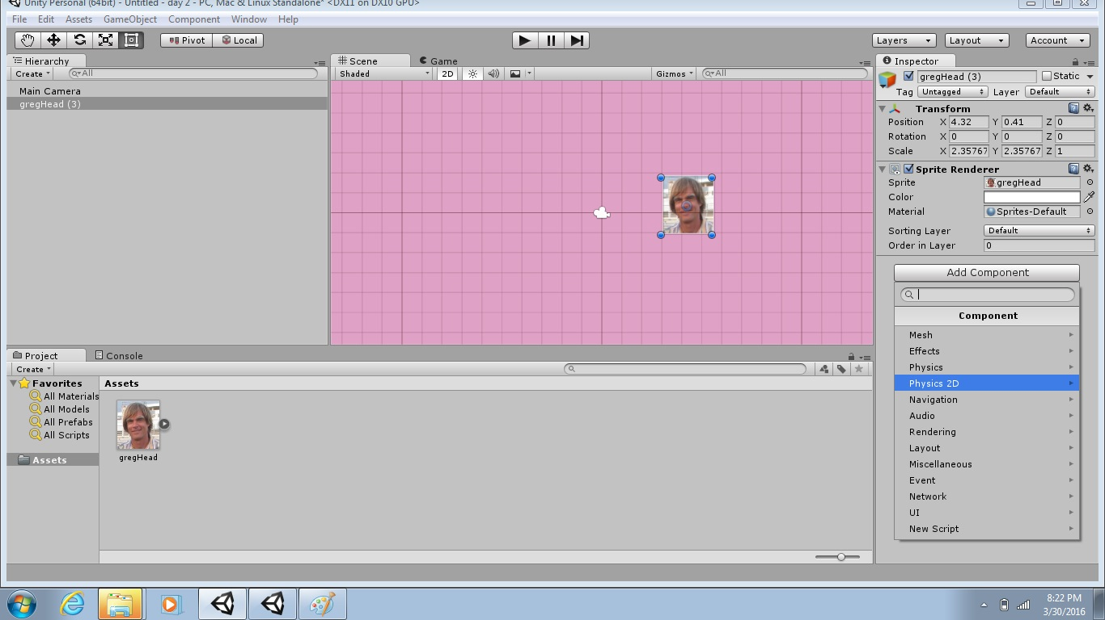
Select “Physics 2D”

Slide 6
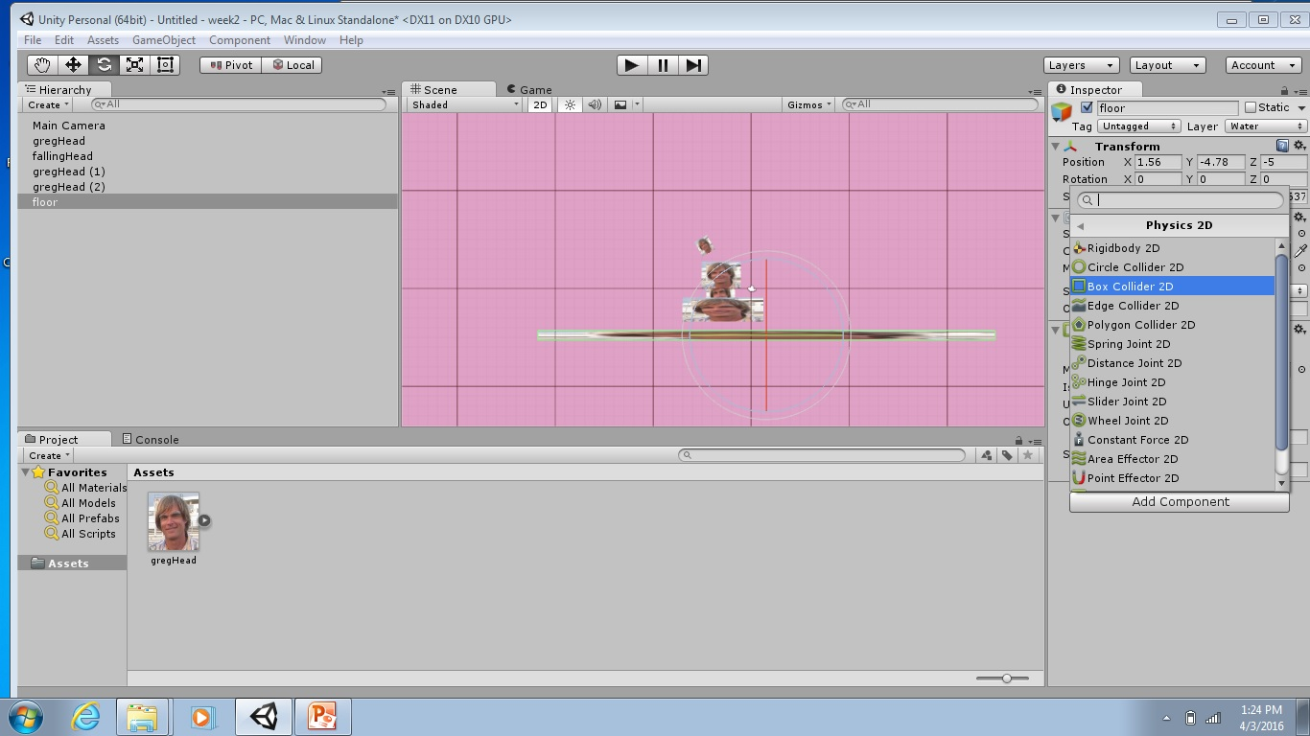
Select “Box Collider 2D”

Slide 7

Lab
Pinball…

